Slide 1
What I think NDN can be worked on
104321016
朱璟忻

Slide 2
Inspiration
Live broadcast
Subtitles

Slide 3
The Salome Experience:Opera Live Streaming and Beyond
Android App : “Don’t Miss the Buffet”
Second Screen
ZoomPad

Slide 4
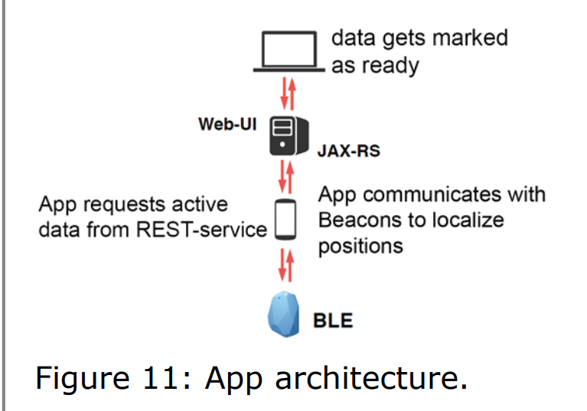

Slide 5
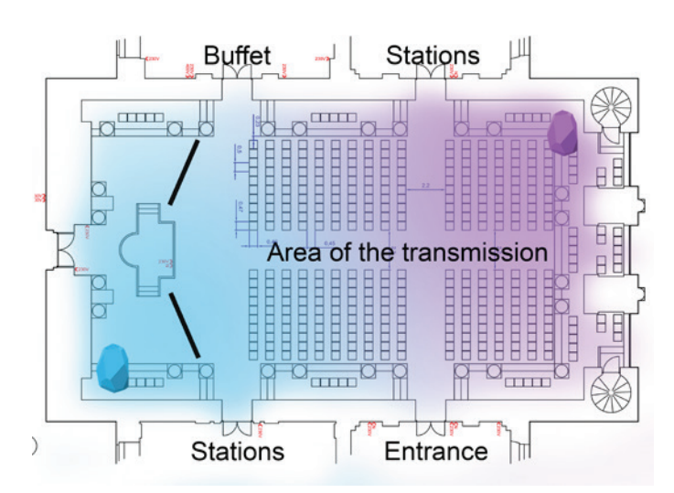

Slide 6
NDN Application
Music Festivals take place in the manors
Know the summaries of parts of the performance wherever you are.

Slide 7
What I’ll do next
Using AR to see the subtitles is an interesting idea.
Is there any method that I can detect the rhythm and then know the name of the song?

Slide 8
Thank you

